Slide 1
MONGO DB
Rohit Jain || Full Stack Trainer (Responsive Design, MERN, PHP) || Exp: 10 years

Slide 2
What is a Database?
A database is an organized collection of data stored and accessed electronically.
More formally, a "database" refers to a set of related data and the way it is organized.
The sizes of databases vary greatly.
Small databases can be stored on a file system, while large databases are hosted on cloud systems.
Rohit Jain || Full Stack Trainer (Responsive Design, MERN, PHP) || Exp: 10 years

Slide 3
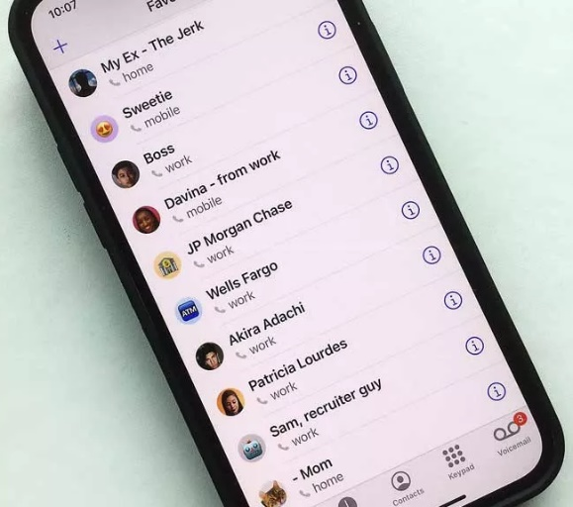
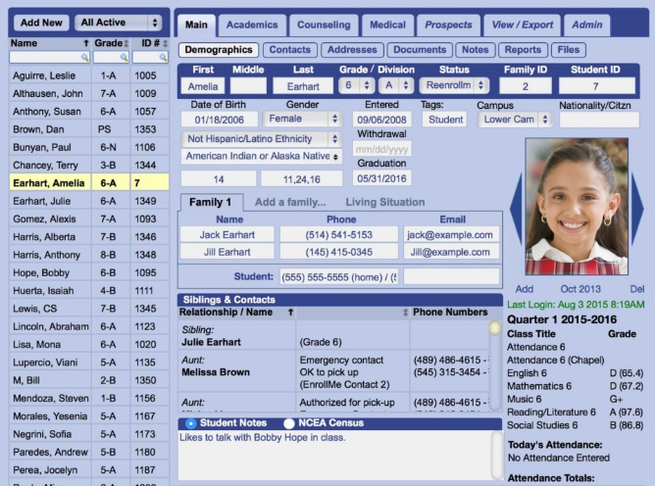
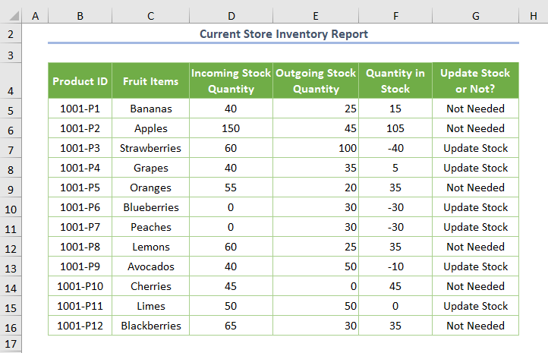
Some Examples…
The contact list in your phone.
Students’ record in your college / university.
Grocery Store Inventory.
And so many more…..
Rohit Jain || Full Stack Trainer (Responsive Design, MERN, PHP) || Exp: 10 years

Slide 4
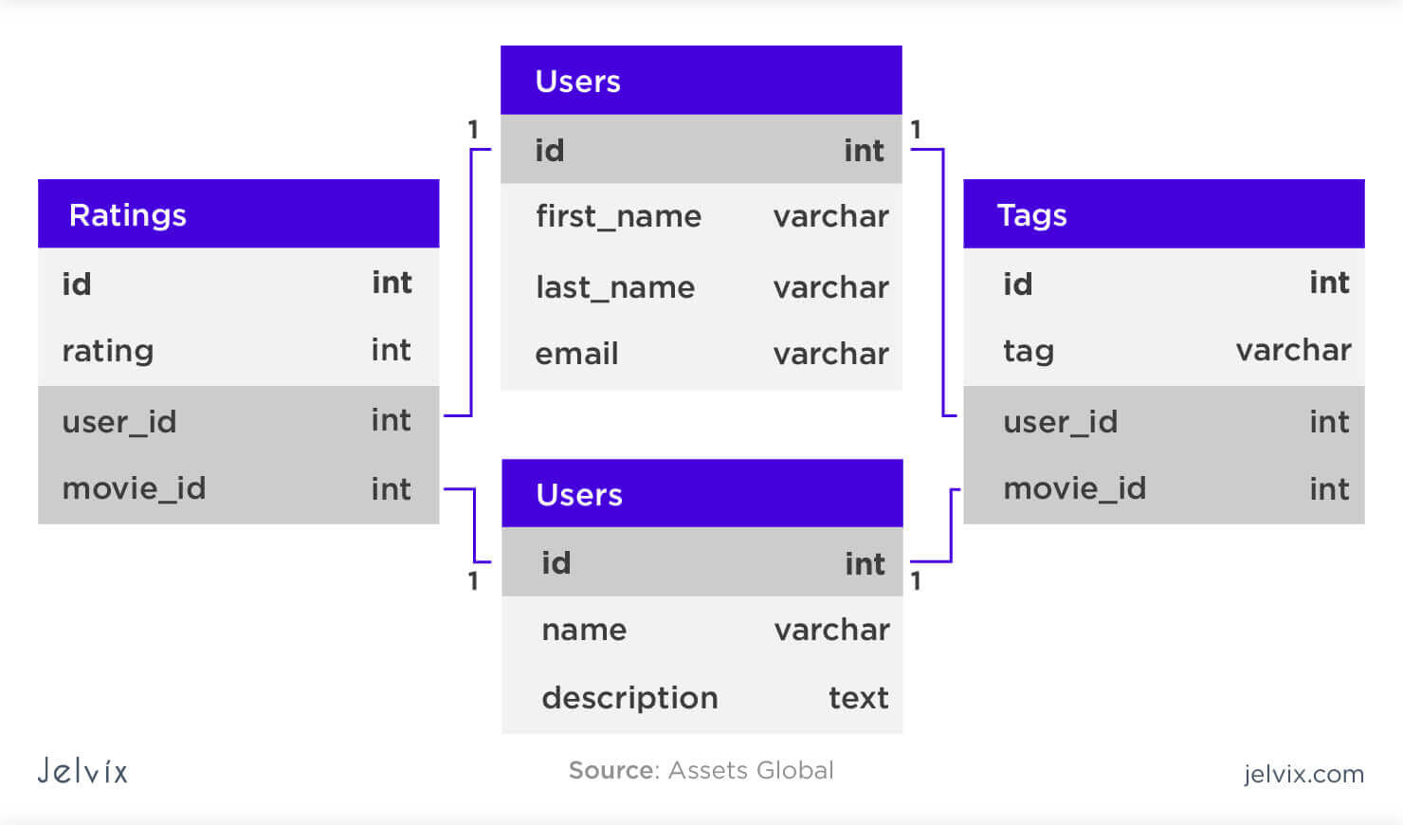
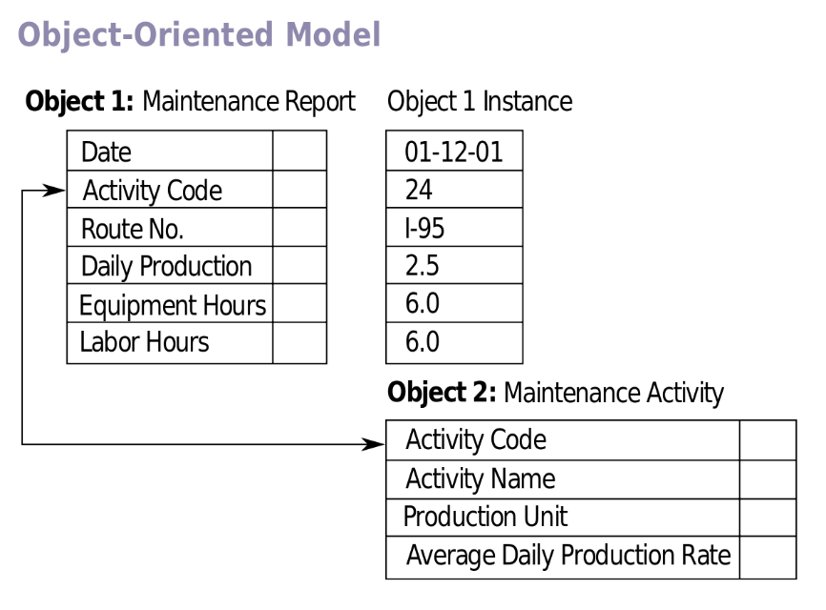
Types of Databases…(1)
Relational Databases:
  Came into existence in 1960s, became dominant in the 1990s.
  Popular examples: IBM Db2, Oracle, MySQL, and Microsoft SQL Server.
  Information is presented to the user as relations, i.e. as a collection of tables with each table consisting of a set of rows and columns.
Object Databases:
  Came into existence in 1980s, to overcome technical difficulties encountered with RDBMS.
  Information is represented in the form of objects as used in object-oriented programming.
  Popular OOBDMS: Jade, ObjectDB (works with Java)
Rohit Jain || Full Stack Trainer (Responsive Design, MERN, PHP) || Exp: 10 years

Slide 5
Types of Databases…(2)
NoSQL Databases:
  Object Databases which came into existence in late 2000s.
  Further divided in
    Key-value Stores,
    Document Oriented Databases,
    Wide Column Stores &
    Graph Databases.
Rohit Jain || Full Stack Trainer (Responsive Design, MERN, PHP) || Exp: 10 years

Slide 6



NoSQL Databases…(1)
Key value stores:
  Designed for storing, retrieving & managing dictionaries or hash tables.
  Dictionaries contain collections of objects or records, which contain many different fields or data.
  These records are stored and retrieved using a key that uniquely identifies the record, and is used to find the data within the database.
  Popular examples: Redis, Memcached, Amazon DynamoDB
  Use Cases: Caching, session management, user preferences.
Redis
Memcached
Amazon
DynamoDB
Rohit Jain || Full Stack Trainer (Responsive Design, MERN, PHP) || Exp: 10 years

Slide 7
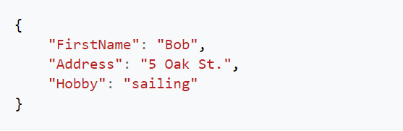
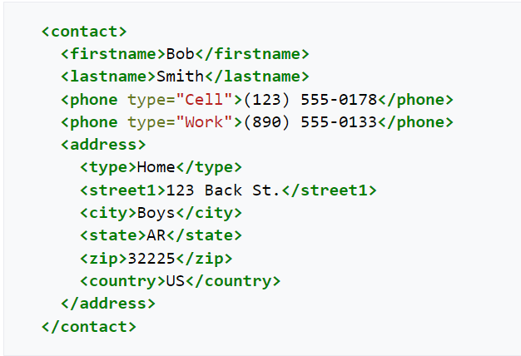


NoSQL Databases…(2)
Document Oriented Databases:
  Also known as document store.
  Designed for storing, retrieving & managing document oriented information.
  The central concept of document oriented databases are the documents containing information in one of these encodings:
    XML, YAML, JSON & BSON
  Use Cases: Content management systems, e-commerce
  applications, real-time analytics.
Rohit Jain || Full Stack Trainer (Responsive Design, MERN, PHP) || Exp: 10 years

Slide 8

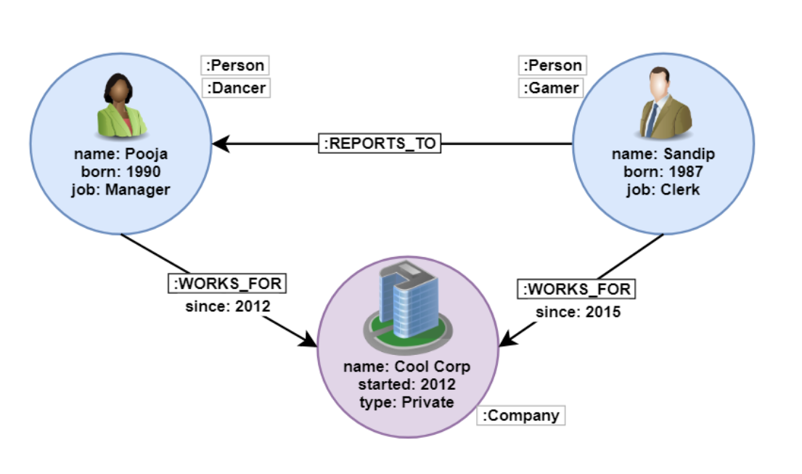
NoSQL Databases…(3)
Graph Databases:
  Uses graph structures for queries with nodes & edges.
  Relates the data items in the store to a collection of nodes and edges.
  The relationships allows data to be linked directly & retrieved faster.
  Querying relationships is fast because they are perpetually stored in the database.
  Useful for heavily inter-connected data
  Popular Examples: Neo4j, Azure Cosmos DB, SAP HANA
  Use Cases: Social networks, fraud detection, network topology.
Rohit Jain || Full Stack Trainer (Responsive Design, MERN, PHP) || Exp: 10 years

Slide 9

You might ask…
WHY TO STUDY NoSQL?
Rohit Jain || Full Stack Trainer (Responsive Design, MERN, PHP) || Exp: 10 years

Slide 10
Why NoSQL Database..?
The rise of Object Oriented Programming Languages.
Which in turn, made possible to store, retrieve & modify data as objects.
Helps programmers to maintain the consistency between the database & the programming language.
With NoSQL data can be stored in form of JSON, XML, YAML and even graphs, which are frequently used to write application logic.
Rohit Jain || Full Stack Trainer (Responsive Design, MERN, PHP) || Exp: 10 years

Slide 11
Why NoSQL Database..?
The data can be stored as collection of documents with structure that can vary from being very flexible to highly rigid.
Are very fast, since these fixed table schemas, and they do not use Joins.
These are designed to scale horizontally, instead of vertical, in case of RDBMS, thus occupying less space.
High speeds. Data stored with NoSQL databases has access to RAM & SSD, which are faster than the HDD where the RDBMS store their data.
Rohit Jain || Full Stack Trainer (Responsive Design, MERN, PHP) || Exp: 10 years

Slide 12
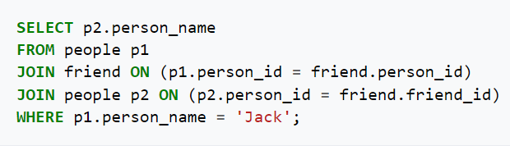
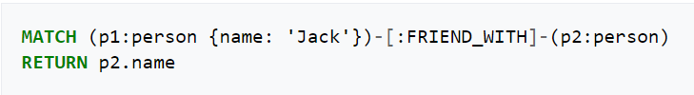
Example…
Imagine a scenario, where we have 2 tables, person & friends.
Person has all the personal information about people, and friends contains list of their friends.
To find all of Jack’s friends, the SQL query would be:
The same query with Graph Database, a type of NoSQL could be:
Rohit Jain || Full Stack Trainer (Responsive Design, MERN, PHP) || Exp: 10 years

Slide 13
You might ask…
HOW ARE THEY DIFFERENT FROM SQL?
Rohit Jain || Full Stack Trainer (Responsive Design, MERN, PHP) || Exp: 10 years

Slide 14
Key Differences…(1)
FACTORS | SQL | NoSQL
Data Model | Structured schemas with tables, rows & columns. | Supports various data models, including document, key-value, wide-column, and graph formats.
Scalability | Scaled vertically by adding more resources to a single server. | Scaled horizontally across multiple servers.
Flexibility | Rigid schemas requiring predefined structures. | Flexible schemas allowing dynamic data structures.
Transactions | Strong ACID (Atomicity, Consistency, Isolation, Durability) compliance. | Varying levels of consistency and may prioritize availability and partition tolerance
Rohit Jain || Full Stack Trainer (Responsive Design, MERN, PHP) || Exp: 10 years

Slide 15
Key Differences…(2)
FACTORS | SQL | NoSQL
Query Language | Structured Query Language (SQL) for defining and manipulating data. | Various APIs and query languages tailored to the specific NoSQL type (e.g., MongoDB Query Language).
Use Cases | Suitable for applications requiring complex transactions and data integrity, such as banking systems. | Ideal for applications with large-scale data, real-time analytics, content management, and flexible data models, such as social media platforms.
Rohit Jain || Full Stack Trainer (Responsive Design, MERN, PHP) || Exp: 10 years

Slide 16
You might ask…
Where does MongoDB fit in?
Rohit Jain || Full Stack Trainer (Responsive Design, MERN, PHP) || Exp: 10 years

Slide 17
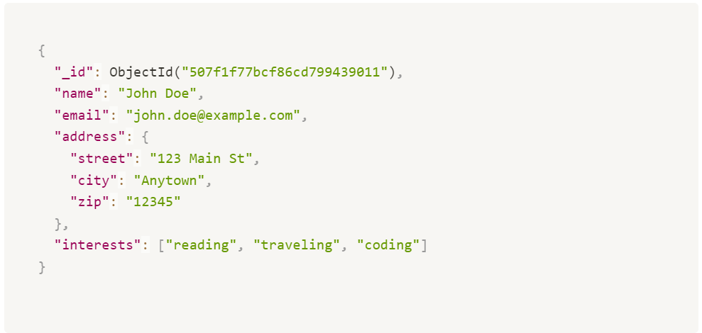
MongoDB…
MongoDB is a document-oriented NoSQL database that stores data in JSON-like BSON documents, allowing for flexible and hierarchical data structures without the need for predefined schemas.
The primary data unit is the document, which is a BSON (Binary JSON) object.
Documents are grouped into collections, which are analogous to tables in SQL databases.
Rohit Jain || Full Stack Trainer (Responsive Design, MERN, PHP) || Exp: 10 years

Slide 18
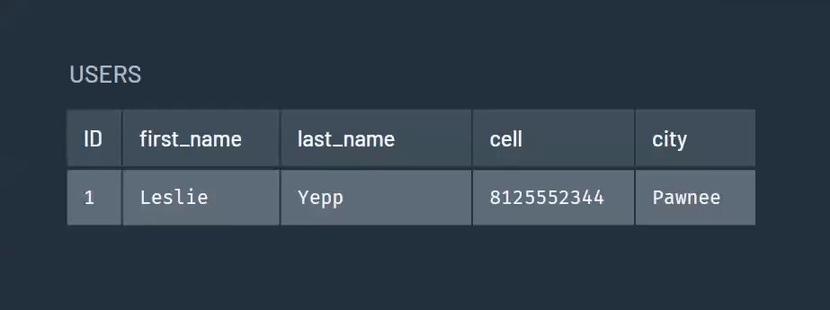
SQL v/s MongoDB…(1)
We will store the same information in both SQL & MongoDB.
Let’s say we want to store info about a user named Leslie.
In SQL, we would create a table ‘user’ with column for each piece of information, with id as a unique identifies to identify each user.
Rohit Jain || Full Stack Trainer (Responsive Design, MERN, PHP) || Exp: 10 years

Slide 19
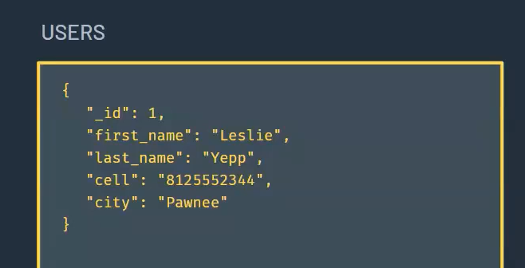
SQL v/s MongoDB…(2)
In Mongo, we would create a document with key-value pairs for each piece of information.
With _id as the unique identifier
Rohit Jain || Full Stack Trainer (Responsive Design, MERN, PHP) || Exp: 10 years

Slide 20
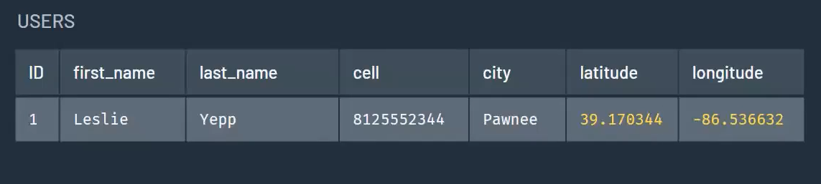
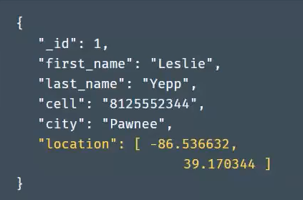
SQL v/s MongoDB…(3)
Let’s add her current location to the DB in form of latitude & longitude.
Rohit Jain || Full Stack Trainer (Responsive Design, MERN, PHP) || Exp: 10 years

Slide 21
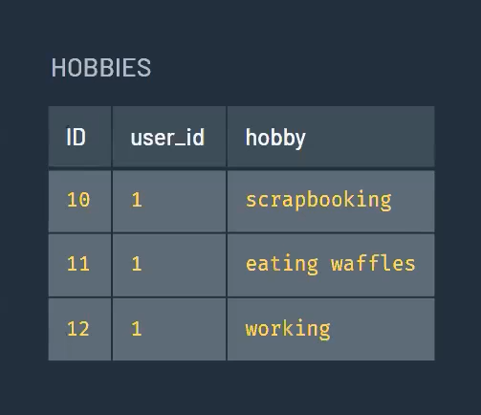
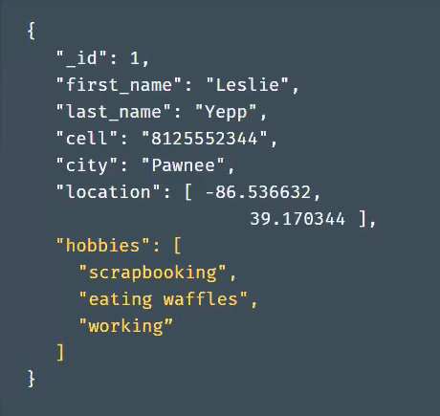
SQL v/s MongoDB…(4)
Let’s also add her hobbies. Here comes the problem with RDBMS.
Since single user could have multiple hobbies, in SQL we need to create a separate table.
And then join the two tables to get data for Leslie.
Since Mongo DB can store arrays, there is no need to have a separate document. Hence no need for join.
Rohit Jain || Full Stack Trainer (Responsive Design, MERN, PHP) || Exp: 10 years

Slide 22
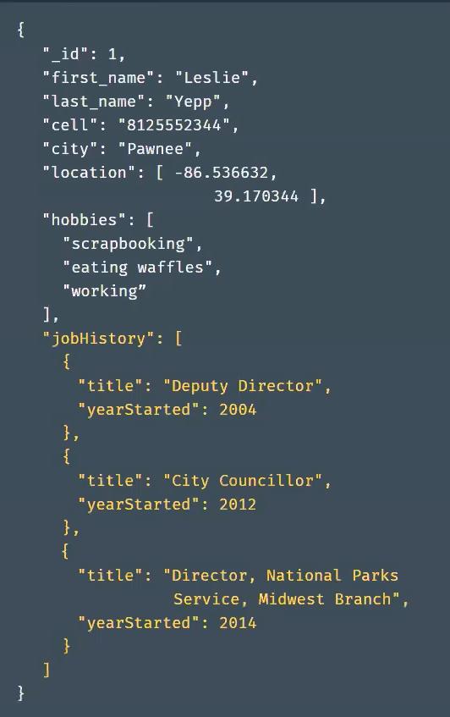
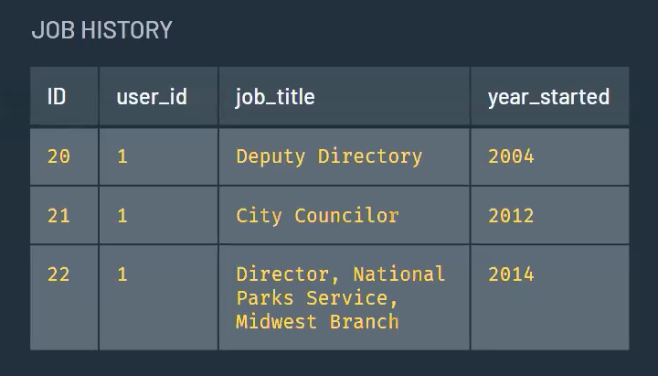
SQL v/s MongoDB…(5)
This time we want to add Leslie’s job history to the DB.
For that we will create another table in SQL DB
Rohit Jain || Full Stack Trainer (Responsive Design, MERN, PHP) || Exp: 10 years

Slide 23
Term Mapping:
Drawing comparisons in the names or terms.
Rohit Jain || Full Stack Trainer (Responsive Design, MERN, PHP) || Exp: 10 years

Slide 24
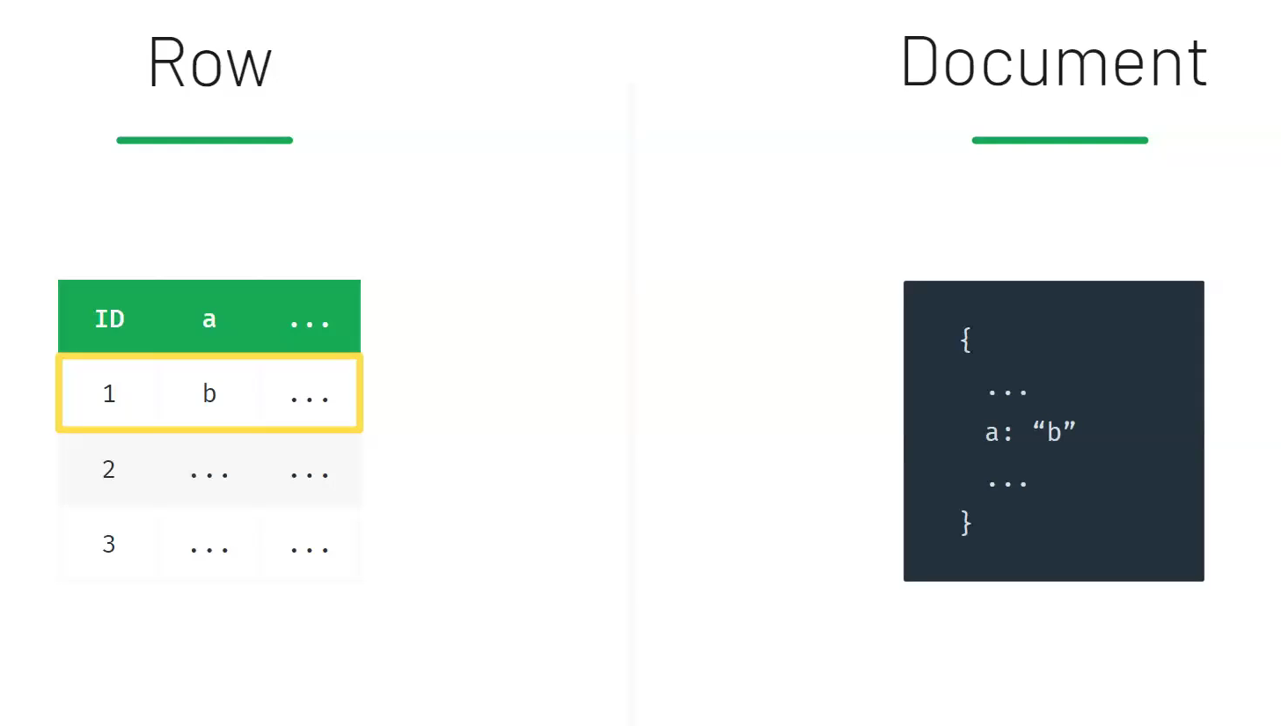
Term Mapping…(1)
Rohit Jain || Full Stack Trainer (Responsive Design, MERN, PHP) || Exp: 10 years

Slide 25
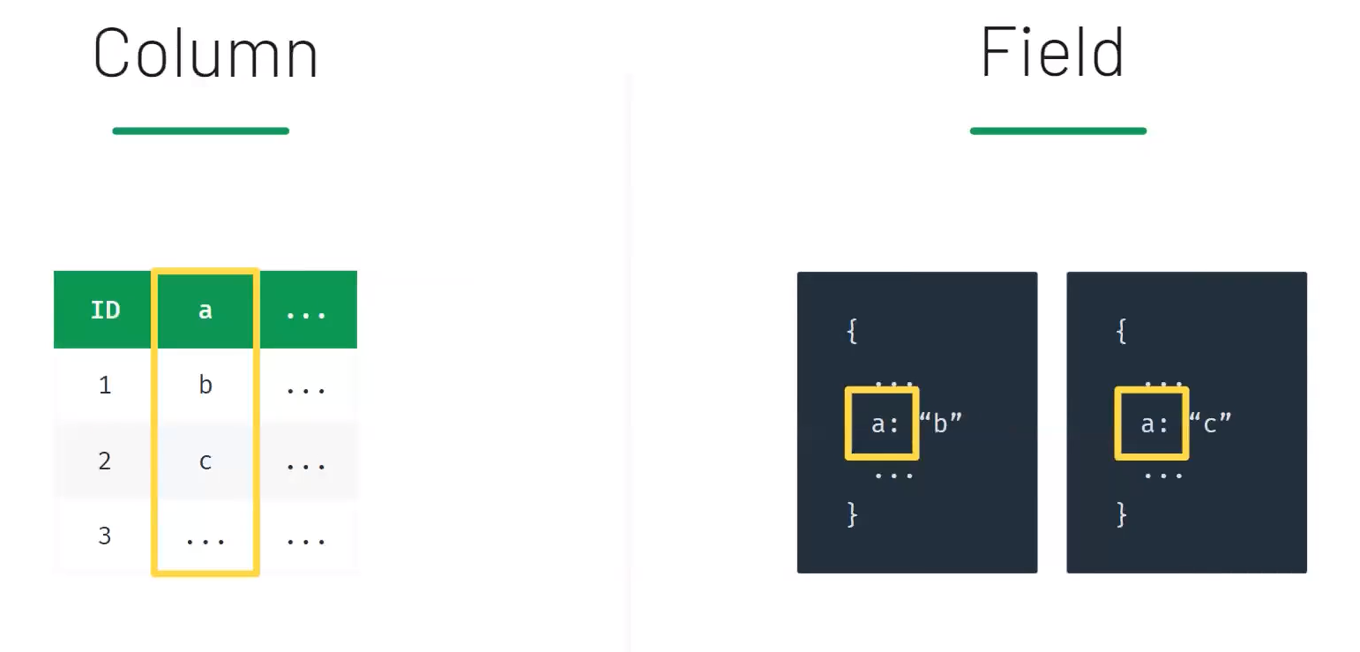
Term Mapping…(2)
Rohit Jain || Full Stack Trainer (Responsive Design, MERN, PHP) || Exp: 10 years

Slide 26
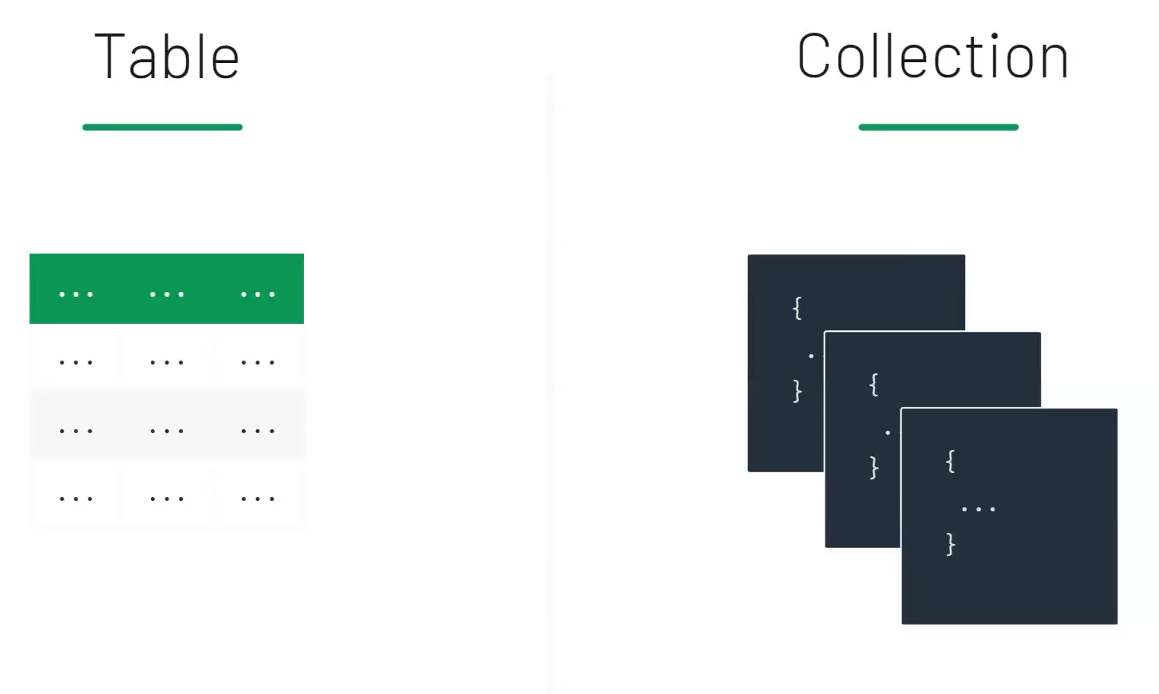
Term Mapping…(3)
Rohit Jain || Full Stack Trainer (Responsive Design, MERN, PHP) || Exp: 10 years

Slide 27
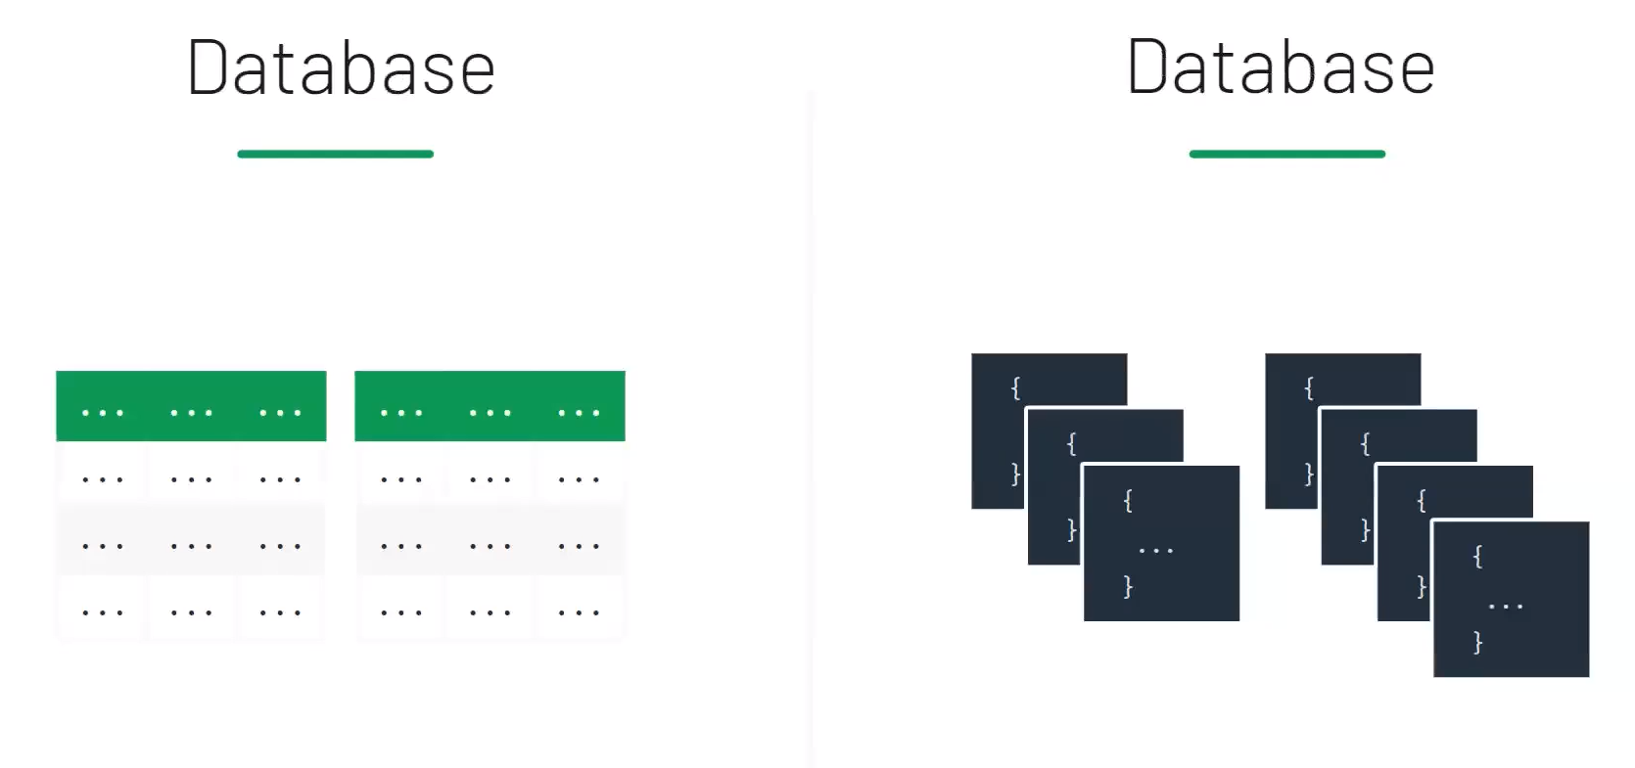
Term Mapping…(4)
Rohit Jain || Full Stack Trainer (Responsive Design, MERN, PHP) || Exp: 10 years

Slide 28
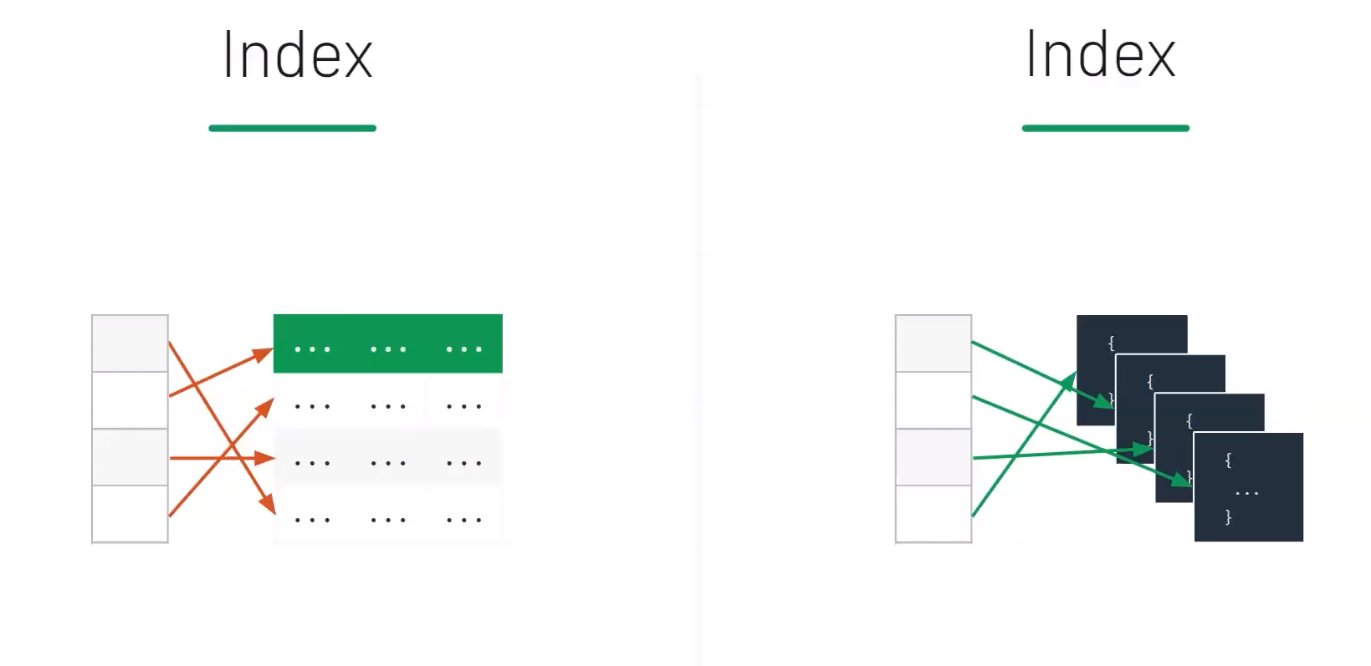
Term Mapping…(5)
Rohit Jain || Full Stack Trainer (Responsive Design, MERN, PHP) || Exp: 10 years

Slide 29
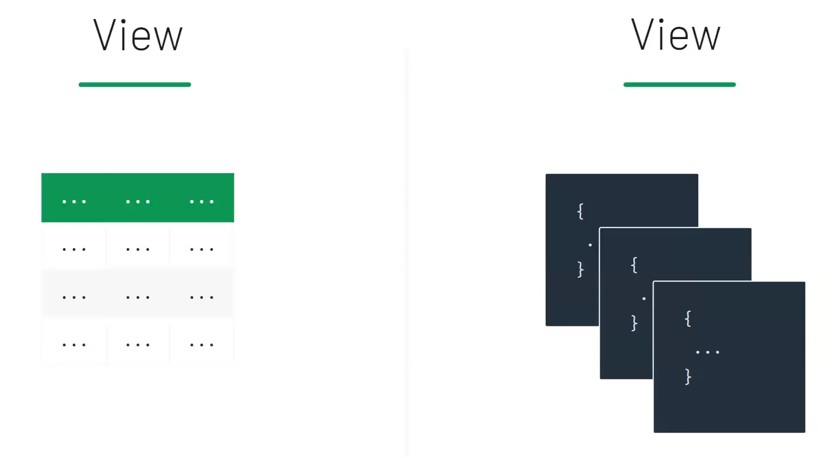
Term Mapping…(6)
Rohit Jain || Full Stack Trainer (Responsive Design, MERN, PHP) || Exp: 10 years

Slide 30
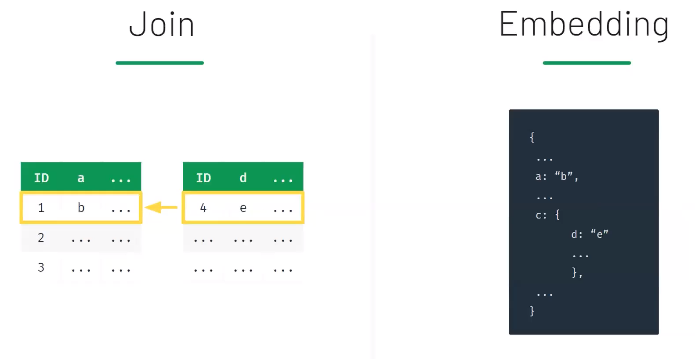
Term Mapping…(7)
Rohit Jain || Full Stack Trainer (Responsive Design, MERN, PHP) || Exp: 10 years

Slide 31
MongoDB Concepts:
Replication
Sharding
Indexes
Aggregation
Rohit Jain || Full Stack Trainer (Responsive Design, MERN, PHP) || Exp: 10 years

Slide 32
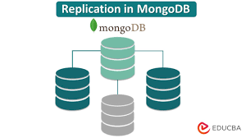
Replication…(1)
Replication in MongoDB is the process of making multiple copies of data across multiple MongoDB servers.
The goal of replication is to improve data availability, fault tolerance, and scalability.
Replication is achieved using a replica set, which is a group of MongoDB instances that share the same data set.
A replica set contains at least two MongoDB instances, including a primary node and secondary nodes.
Rohit Jain || Full Stack Trainer (Responsive Design, MERN, PHP) || Exp: 10 years

Slide 33
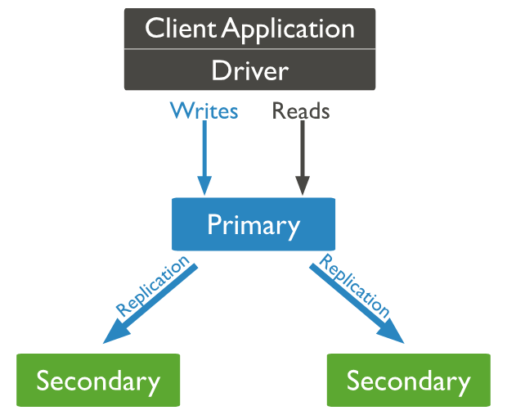
Replication…(2)
Primary Node:
  Handles all write operations.
  Replicates data changes to secondary nodes.
  If the primary fails, an election process selects a new primary from the secondaries.
Secondary Node:
  Maintain copies of the primary's data.
  Can handle read operations if configured
  Continuously replicate data from the primary.
Rohit Jain || Full Stack Trainer (Responsive Design, MERN, PHP) || Exp: 10 years

Slide 34
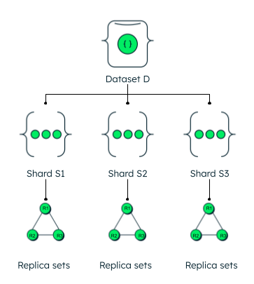
Sharding…
Sharding in MongoDB is a horizontal scaling technique that distributes data across multiple machines or clusters, known as shards.
Each shard holds a subset of the total data, allowing the database to handle large volumes of data and high-throughput operations by parallelizing queries and write operations.
Sharding is used to:
  Scale Out: Accommodate growing data sizes beyond the capacity of a single server.
  Improve Performance: Distribute the load, reducing bottlenecks and enhancing read/write speeds.
  Ensure Availability: Distribute data across different servers or data centers to enhance fault tolerance.
Rohit Jain || Full Stack Trainer (Responsive Design, MERN, PHP) || Exp: 10 years

Slide 35
Indexes…
Indexes in MongoDB are data structures that store a portion of the collection’s data in an easy-to-traverse form, to make queries more efficient.
They work similarly to indexes in books, allowing MongoDB to quickly locate and access the required documents without scanning the entire collection.
Types of Indexes:
  Single Field
  Compound
  Multikey
  Text
  Geospatial
  Hashed
  Unique
  Sparse
Rohit Jain || Full Stack Trainer (Responsive Design, MERN, PHP) || Exp: 10 years

Slide 36
Aggregation…
  In MongoDB, aggregation is a way to process large numbers of documents in a collection by passing them through a series of stages, or pipeline.
  The aggregation pipeline can perform a variety of operations, including:
    Filtering: Narrowing down the list of documents based on a set of criteria.
    Sorting: Reordering documents based on a chosen field.
    Grouping: Processing multiple documents together to form a summarized result.
    Transforming: Changing the structure of documents, such as removing or renaming fields.
Rohit Jain || Full Stack Trainer (Responsive Design, MERN, PHP) || Exp: 10 years

Slide 37
You might be wondering…
When would we install it?
The answer is
RIGHT NOW…..
Rohit Jain || Full Stack Trainer (Responsive Design, MERN, PHP) || Exp: 10 years

